Slide 1
Describe the pieces

Slide 2
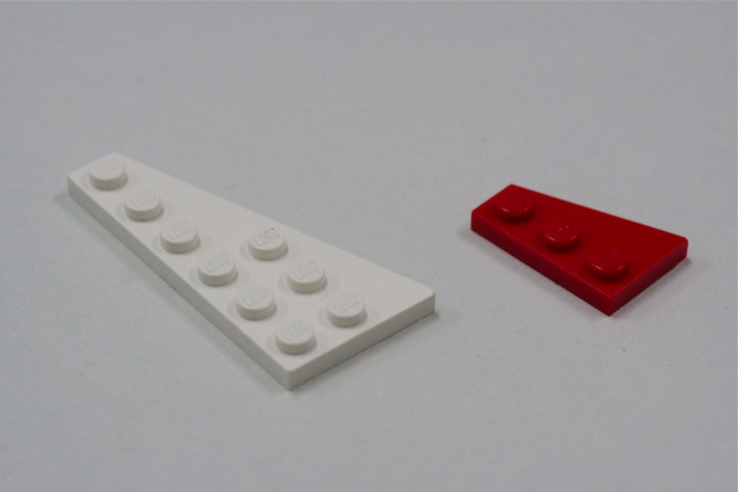

Slide 3
wing/ trapezoid

Slide 4
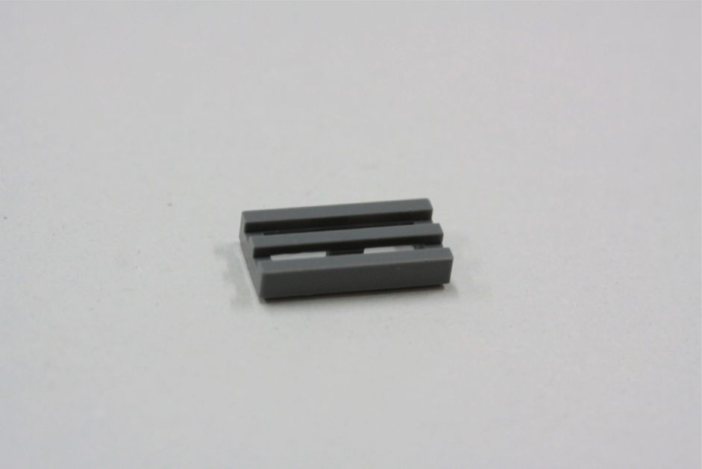

Slide 5
grating/ grill

Slide 6
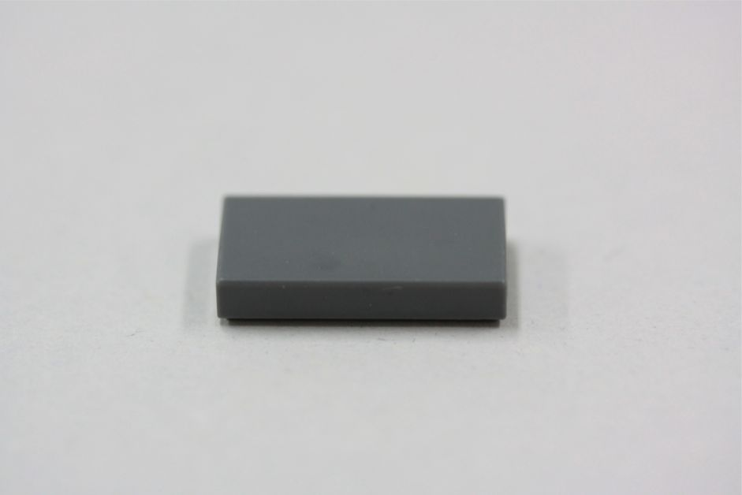

Slide 7
smooth flat surface brick/tile

Slide 8
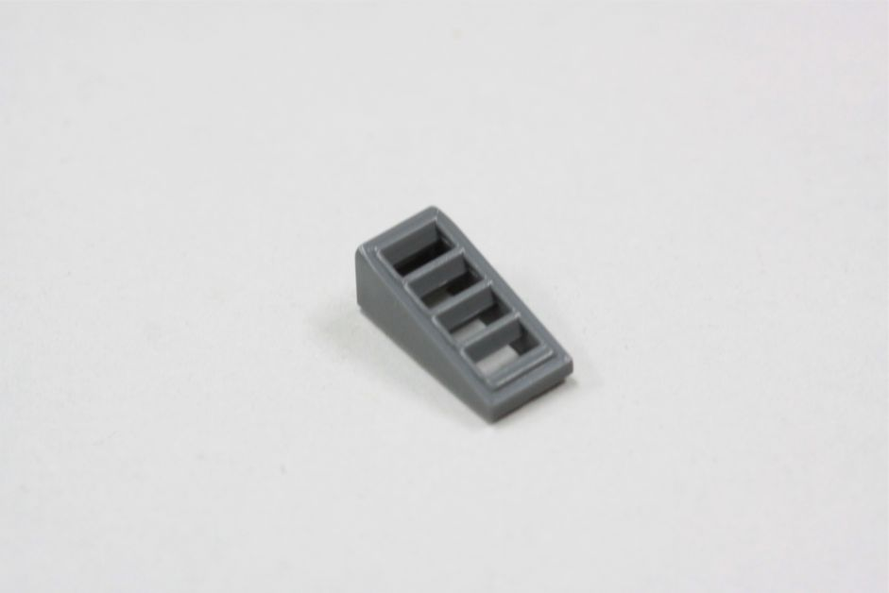

Slide 9
(angled) grill, air duct

Slide 10
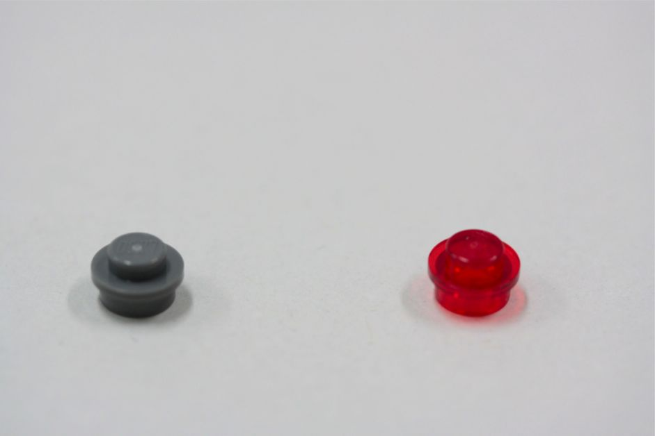

Slide 11
circular button/ single stud/ light parts

Slide 12
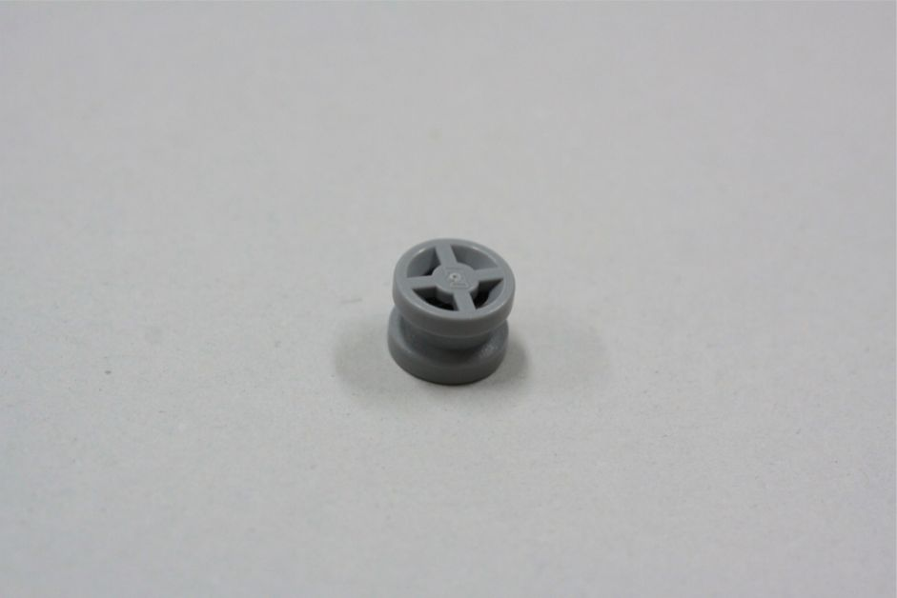

Slide 13
wheel

Slide 14
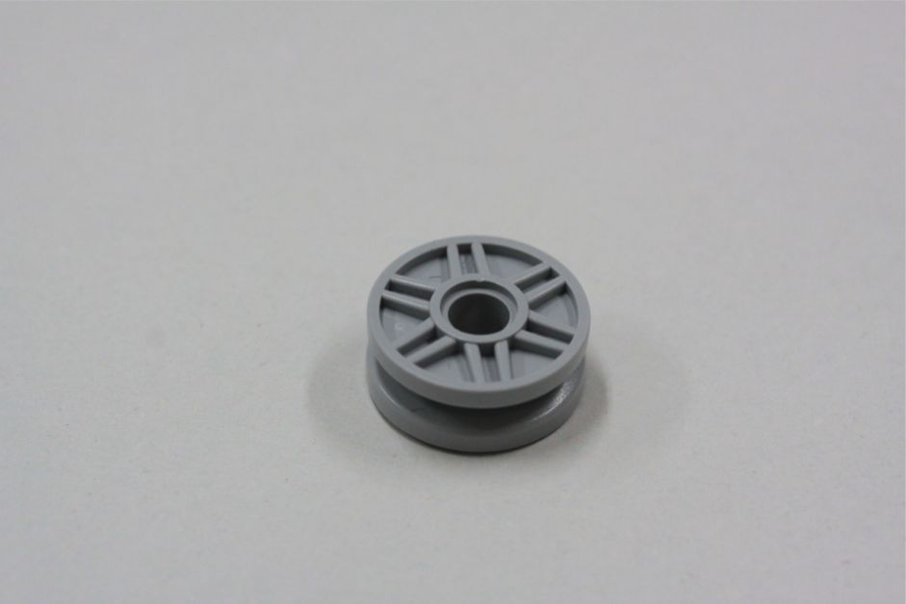

Slide 15
big wheel

Slide 16
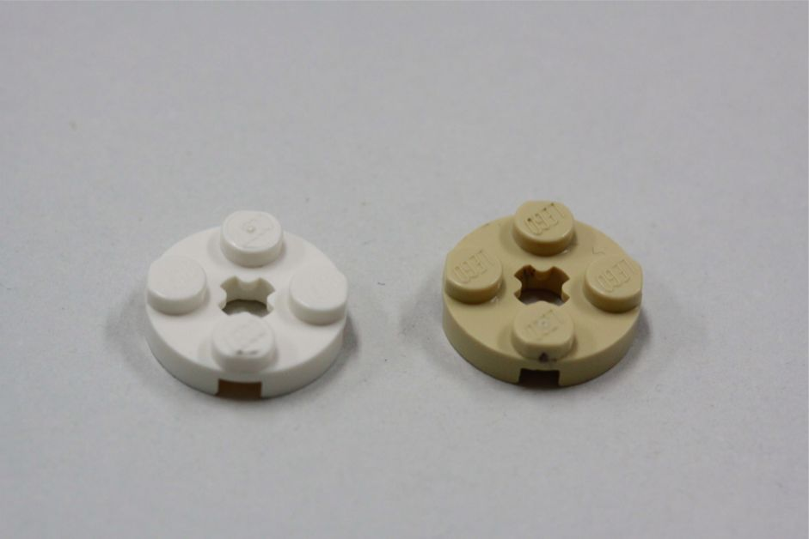

Slide 17
Round/ circular with 4 studs
4 studded disk

Slide 18
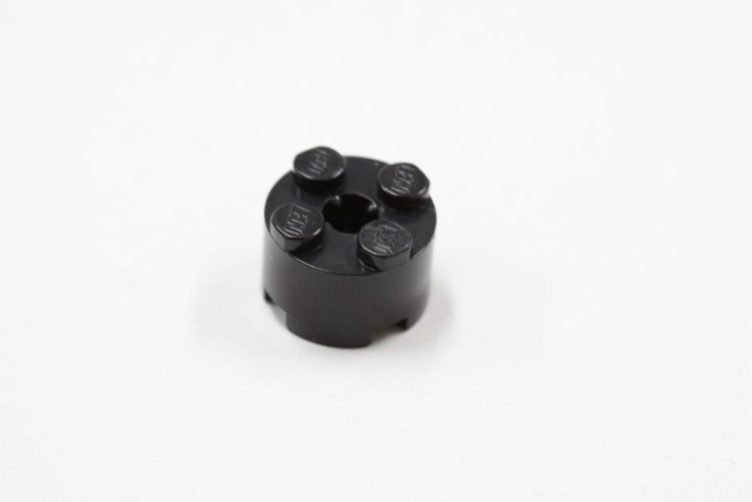

Slide 19
4 studded cylinder

Slide 20
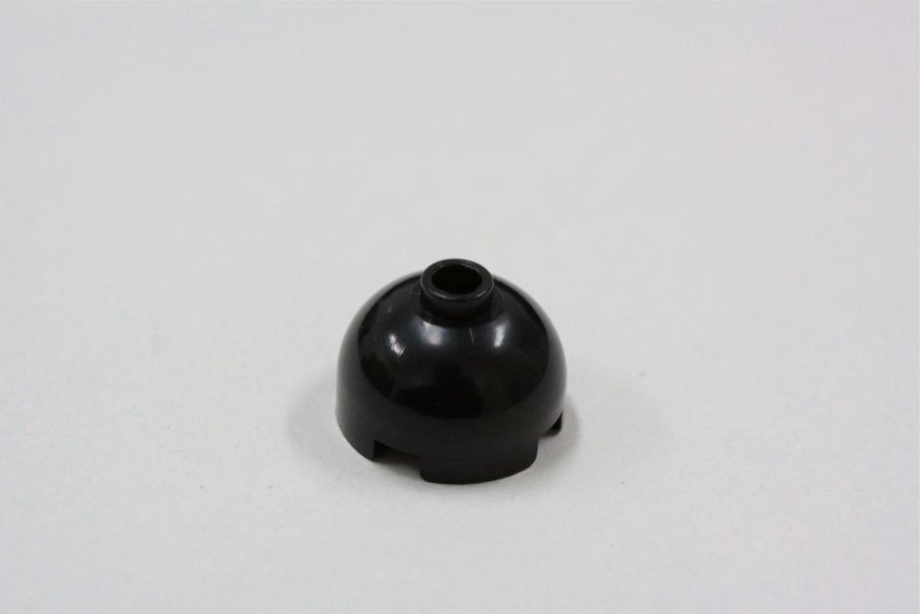

Slide 21
dome/ hemisphere/ half- sphere

Slide 22
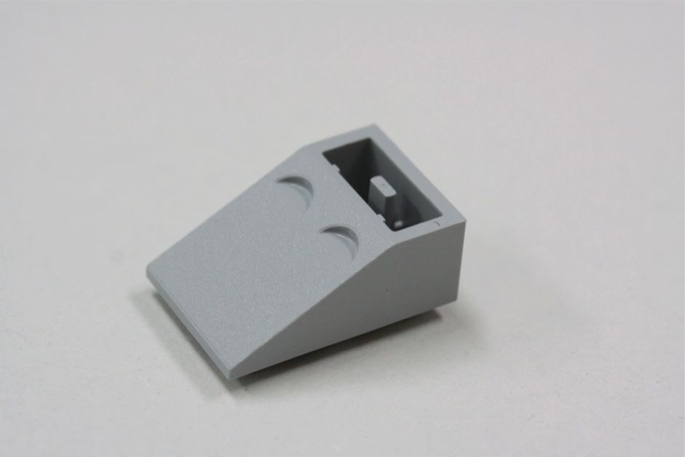

Slide 23
beveled / trapezoid

Slide 24
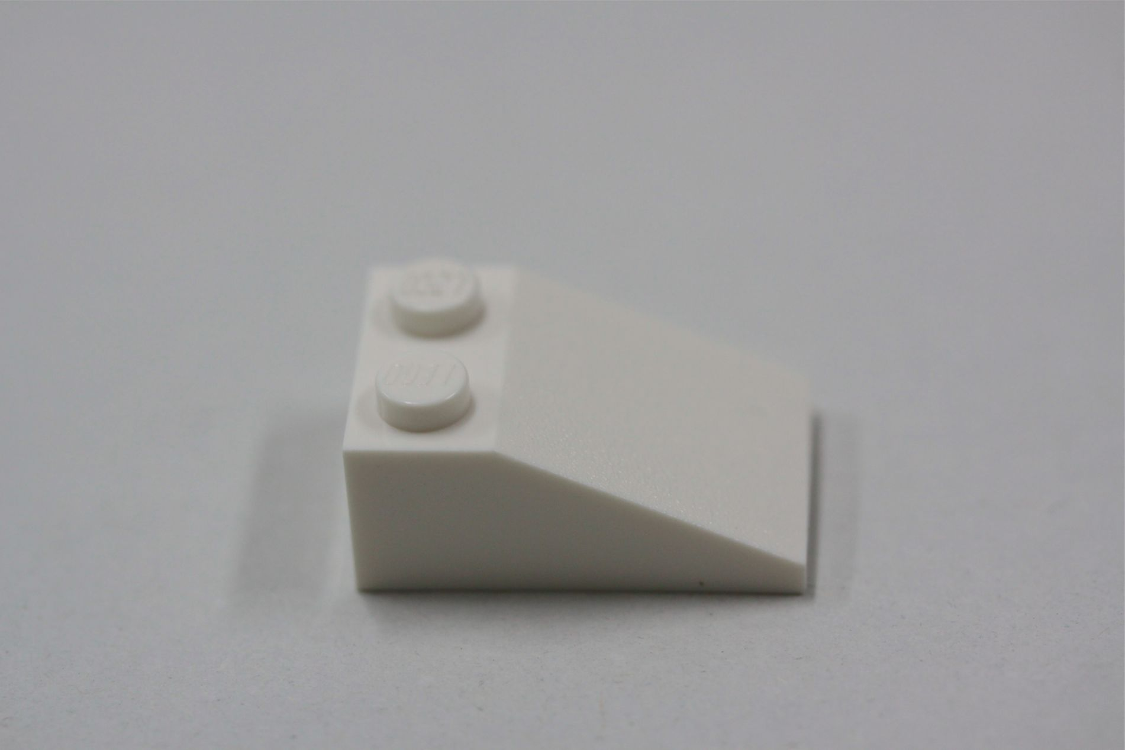

Slide 25
sloped with two studs

Slide 26
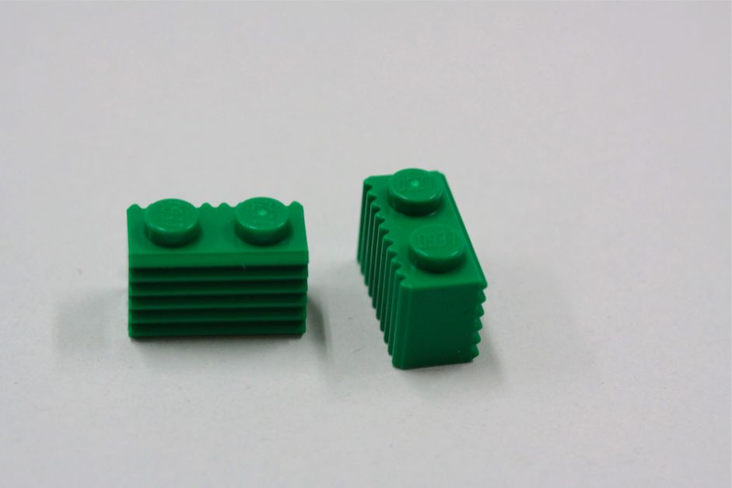

Slide 27
１×２ block with a jagged surface

Slide 28
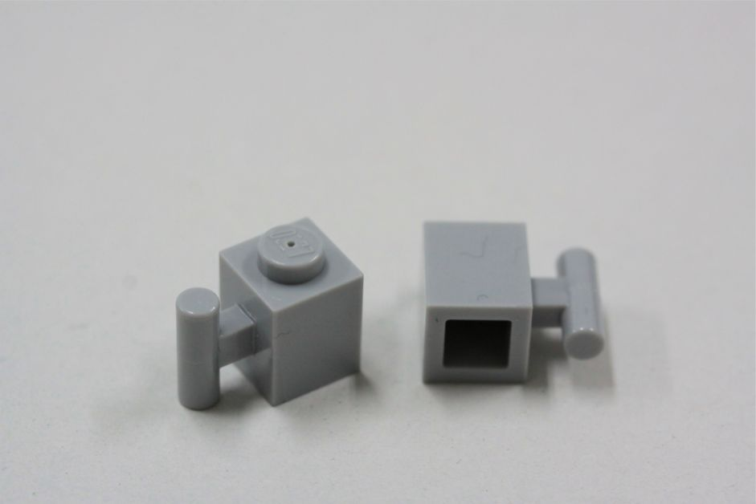

Slide 29
Single studded block with a male hinge

Slide 30
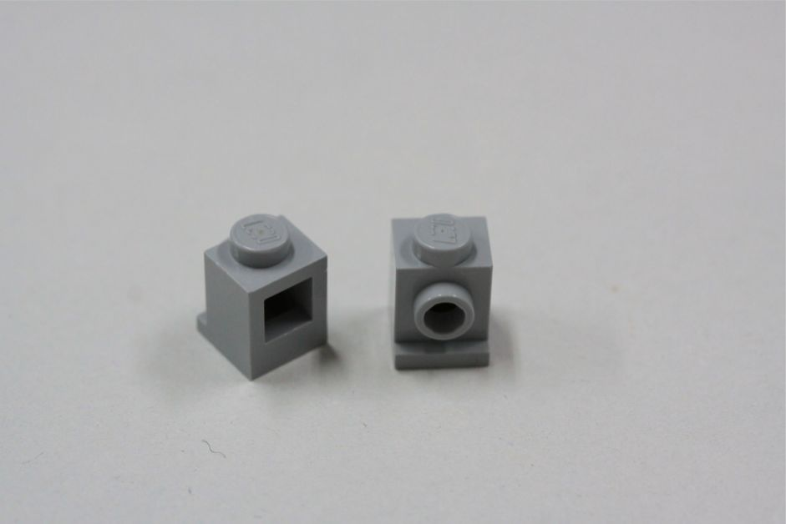

Slide 31
cube with one side facing hole

Slide 32
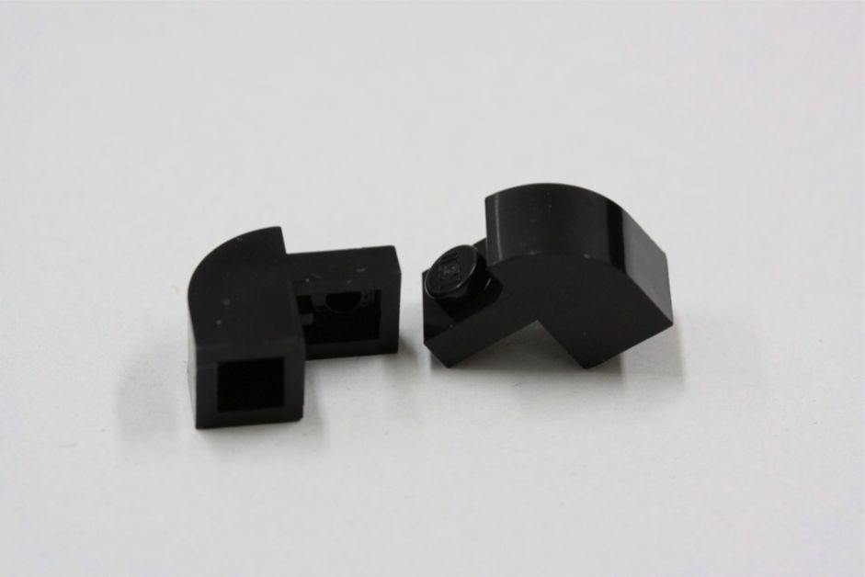

Slide 33
Rounded shoulder block

Slide 34
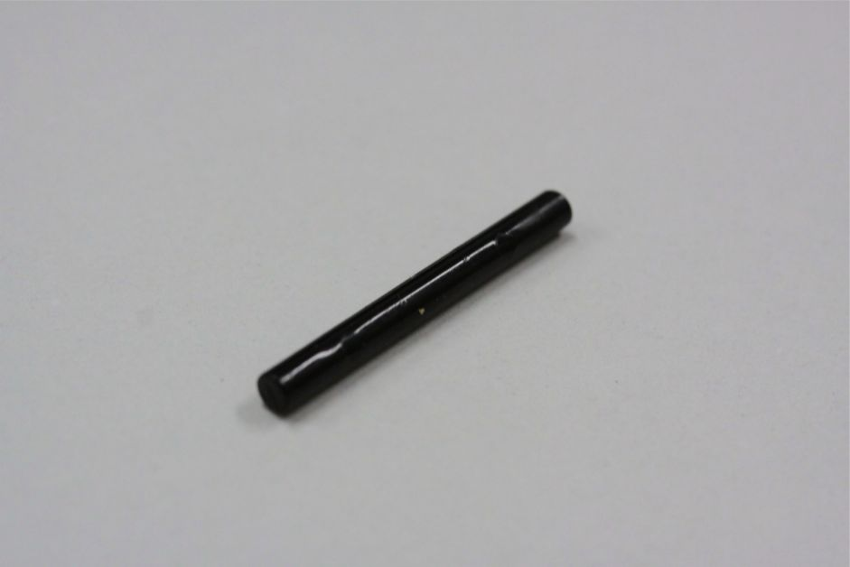

Slide 35
Long pole/bar

Slide 36
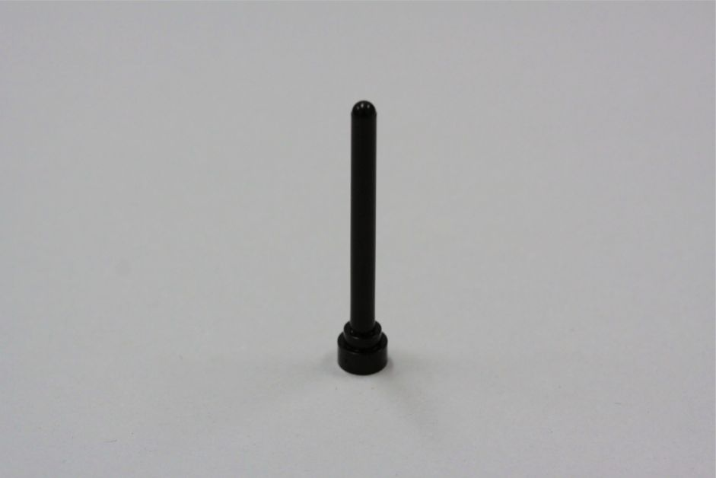

Slide 37
Antennae

Slide 38
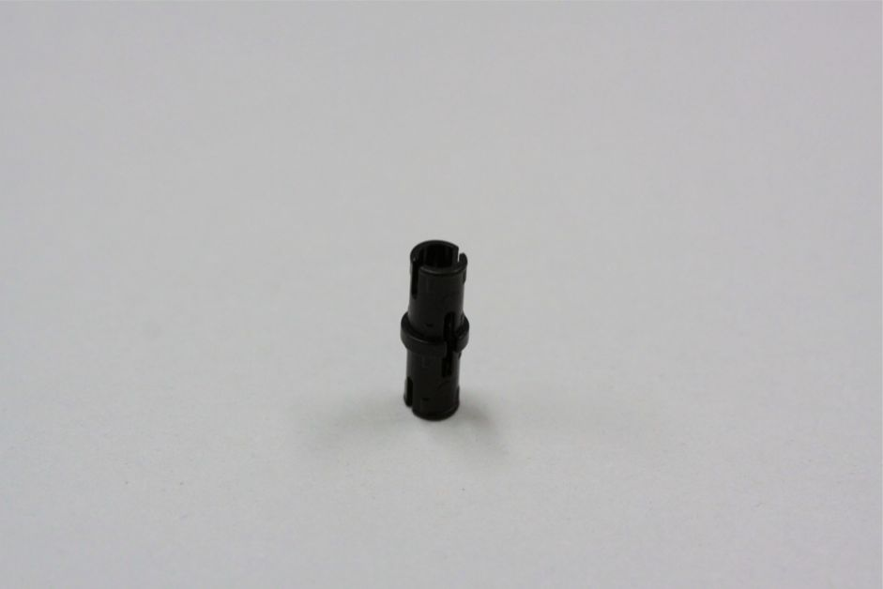

Slide 39
Connector pipe

Slide 40
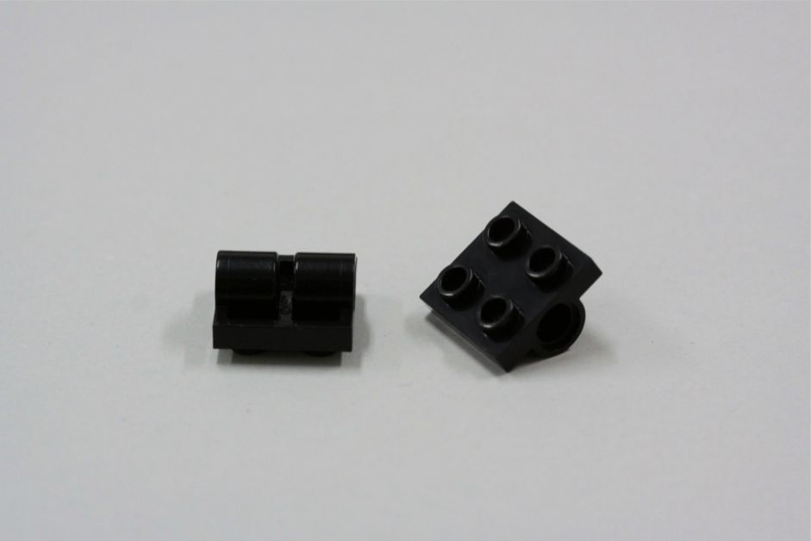

Slide 41
black square with hole

Slide 42
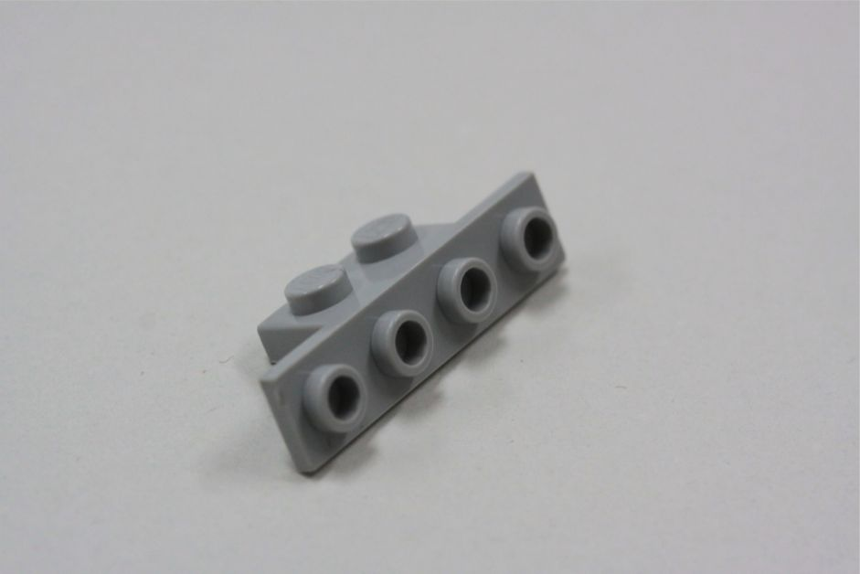

Slide 43
Two studded piece with four front facing hollow studs.

Slide 44
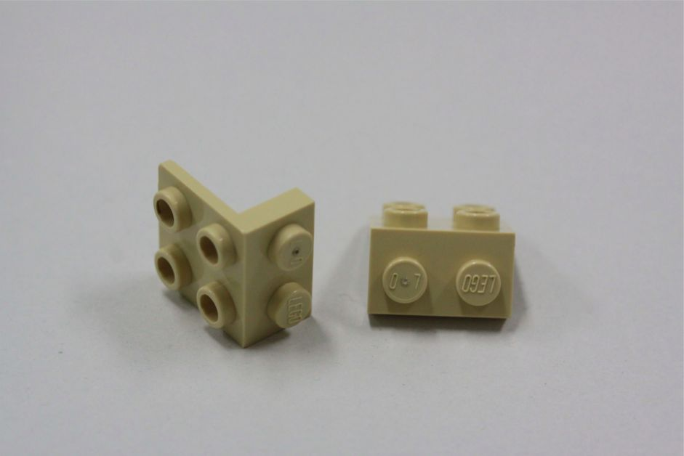

Slide 45
Angled piece 4 dot on the top, 2 dot on the side

Slide 46
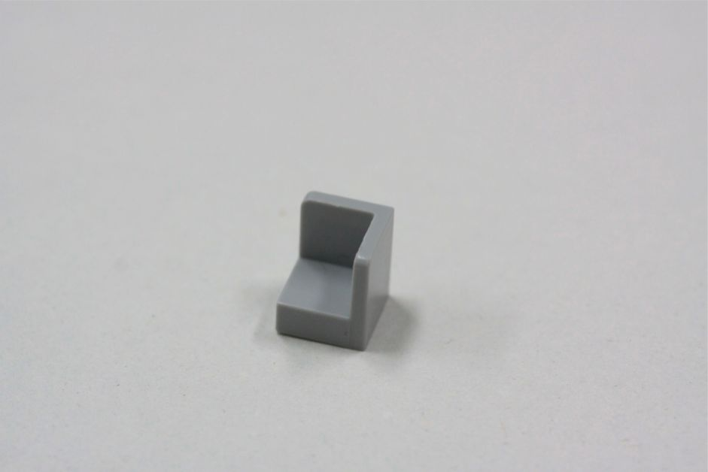

Slide 47
hollowed corner piece

Slide 48
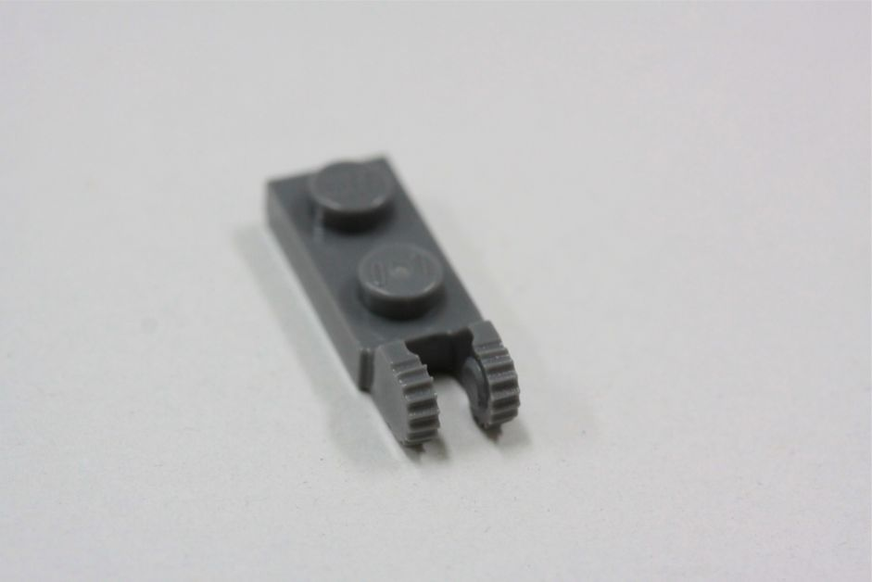

Slide 49
１×２ with an endwise female joint

Slide 50
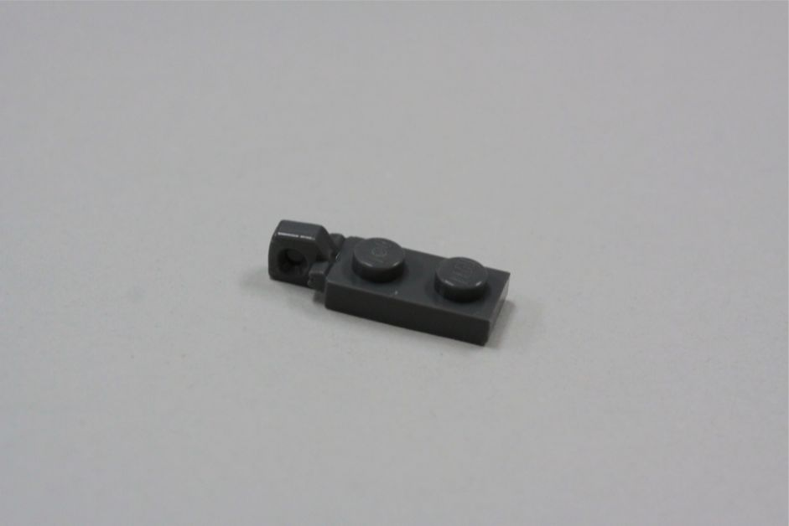

Slide 51
１×２ with an endwise male joint connector

Slide 52
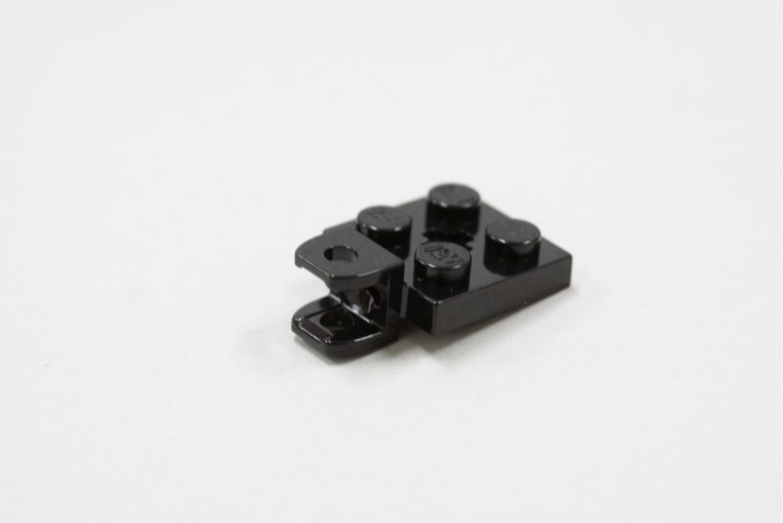

Slide 53
２×２ with horizontal female joint

Slide 54
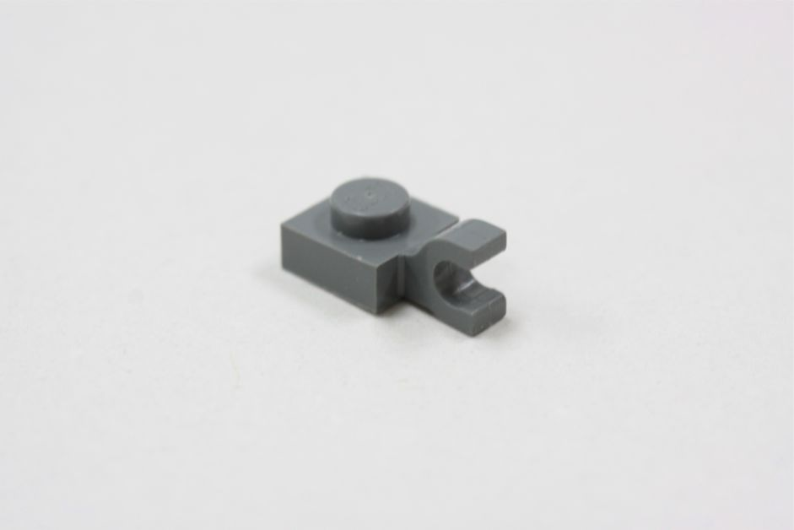

Slide 55
１×１ with horizontal clasp

Slide 56
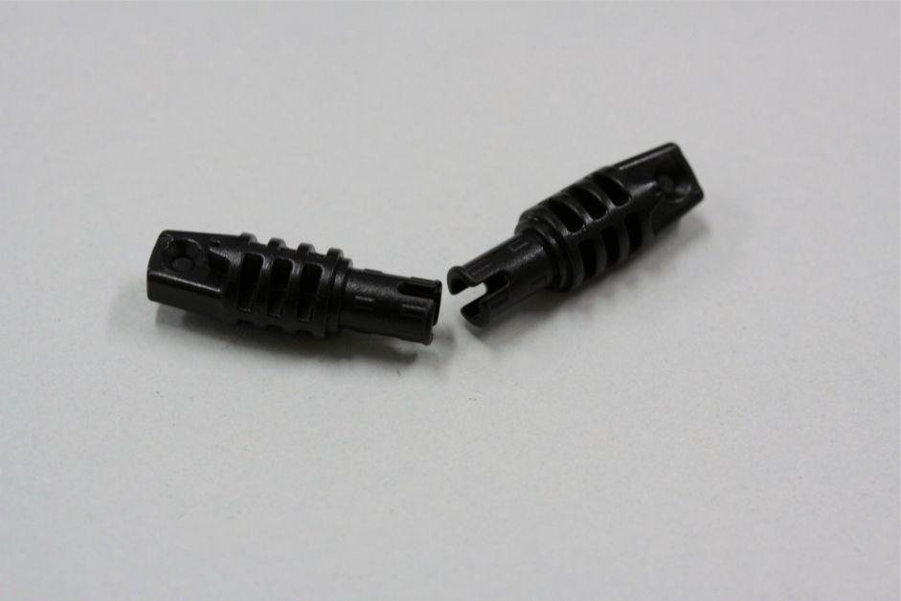

Slide 58
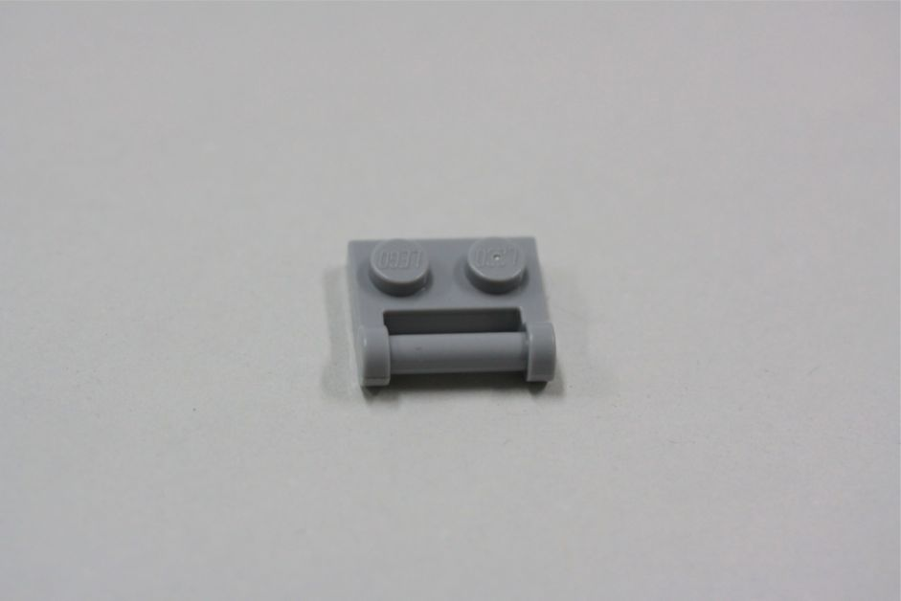

Slide 59
1x2 block with a lengthwise male hinge

Slide 60
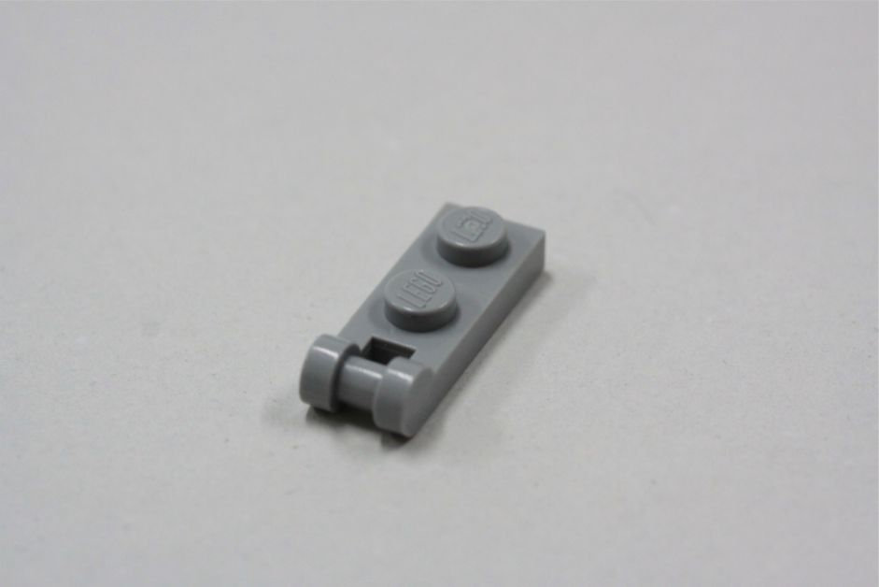

Slide 61
1x2 block with an endwise male hinge

Slide 62
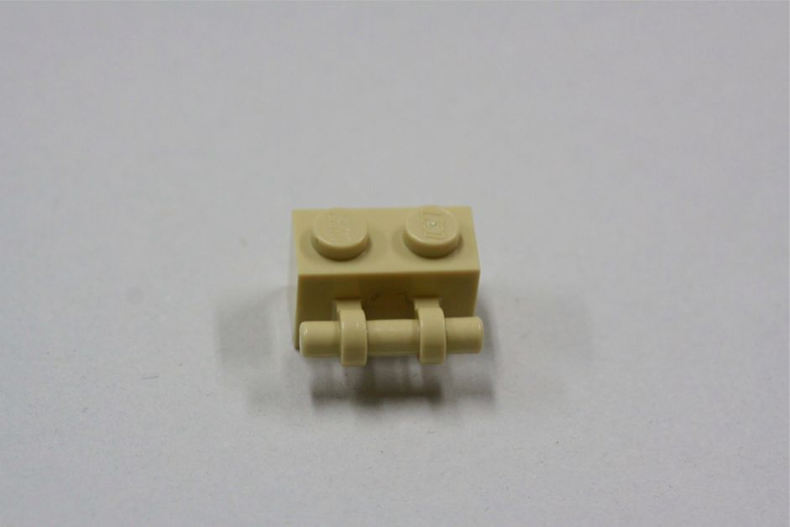

Slide 63
１×２ with a bar

Slide 64
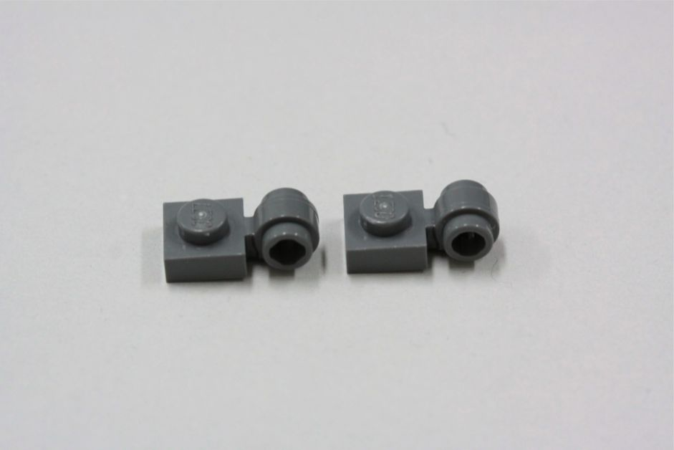

Slide 65
１×１ with hole

Slide 66
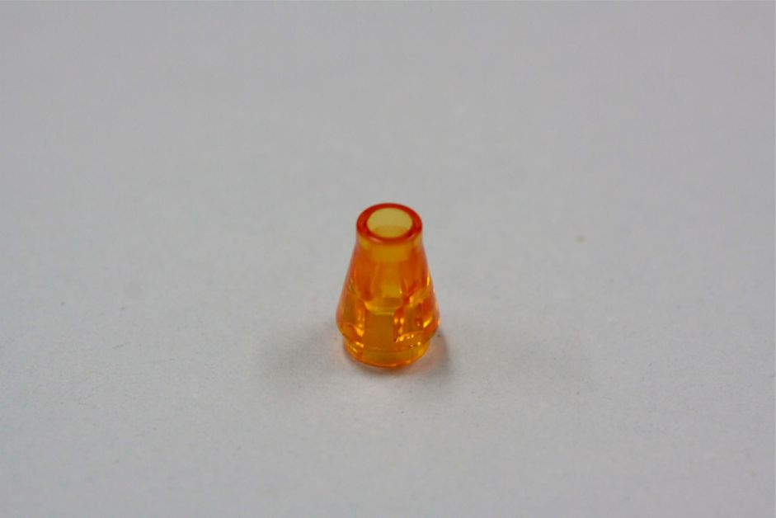

Slide 67
clear orange cone

Slide 68
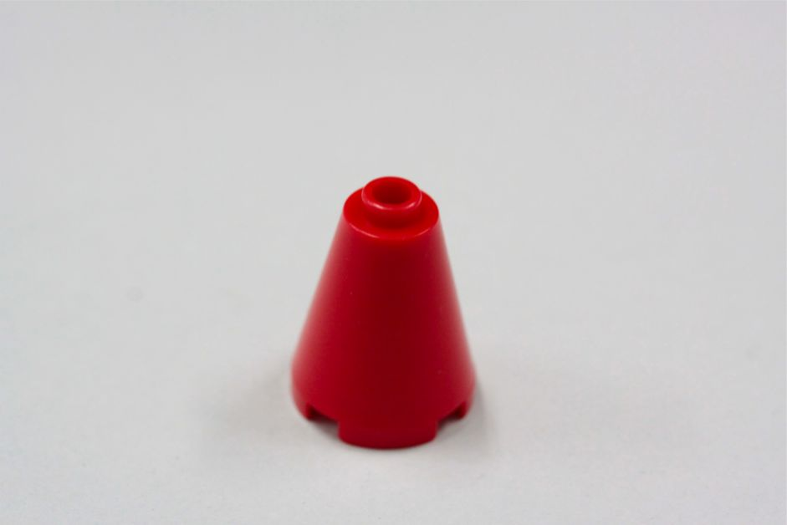

Slide 69
red cone

Slide 70
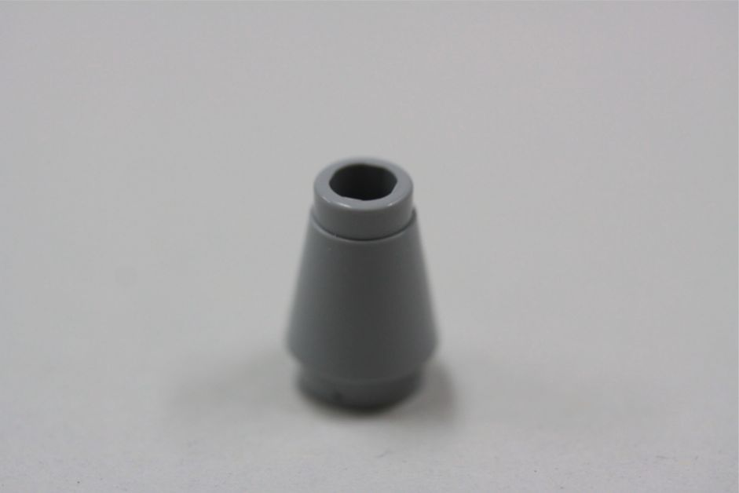

Slide 71
grey cone

Slide 72
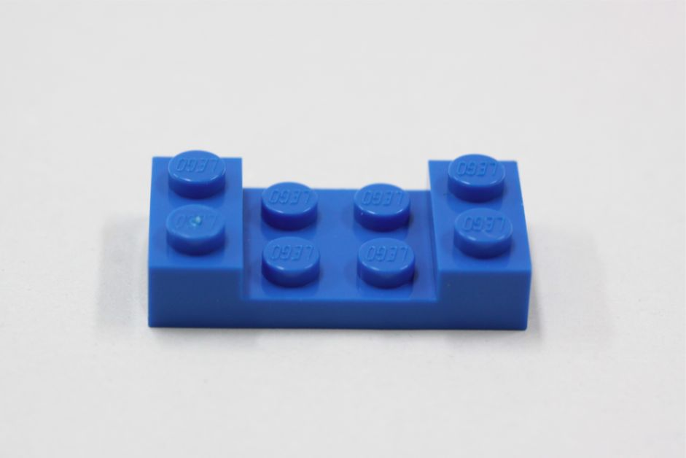

Slide 73
Blue 2×4 with the sides raised

Slide 74
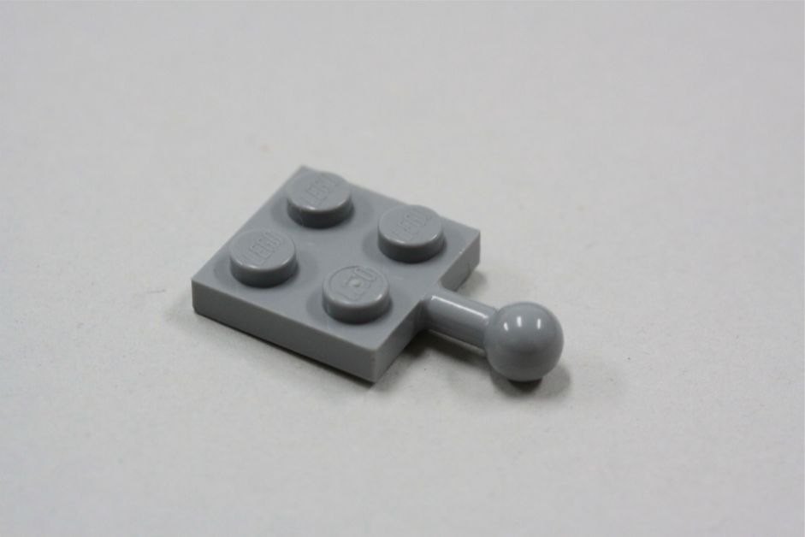

Slide 75
2x2 with a male ball joint

Slide 76
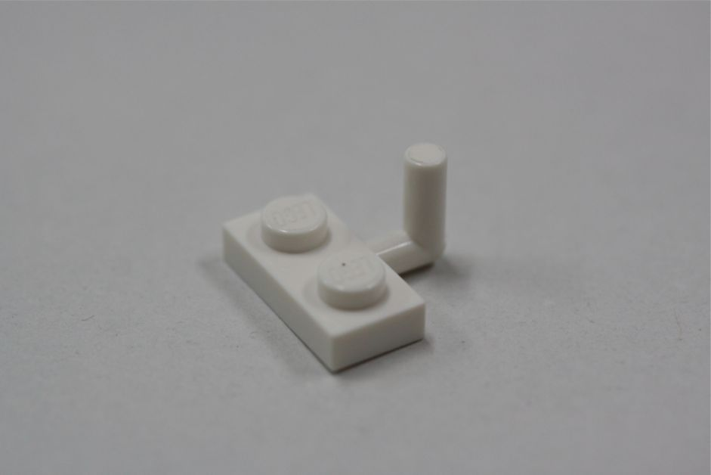

Slide 77
1×2 with chimney

Slide 78
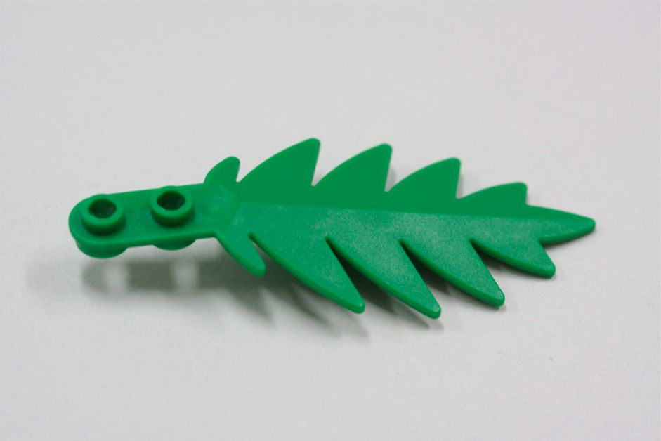

Slide 79
green leaf

Slide 80
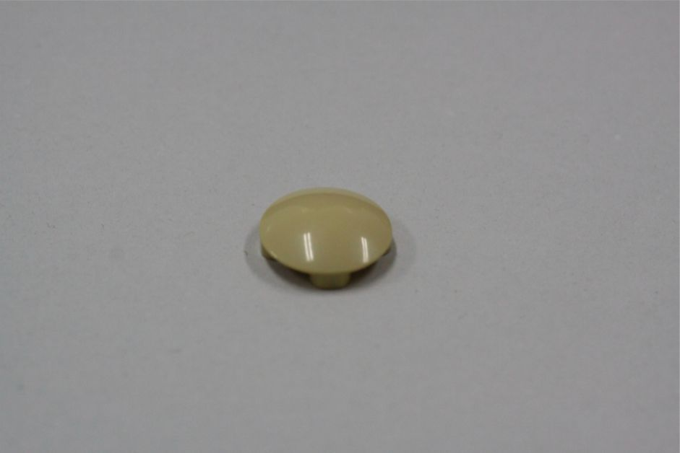

Slide 81
round piece like a lid

Slide 82
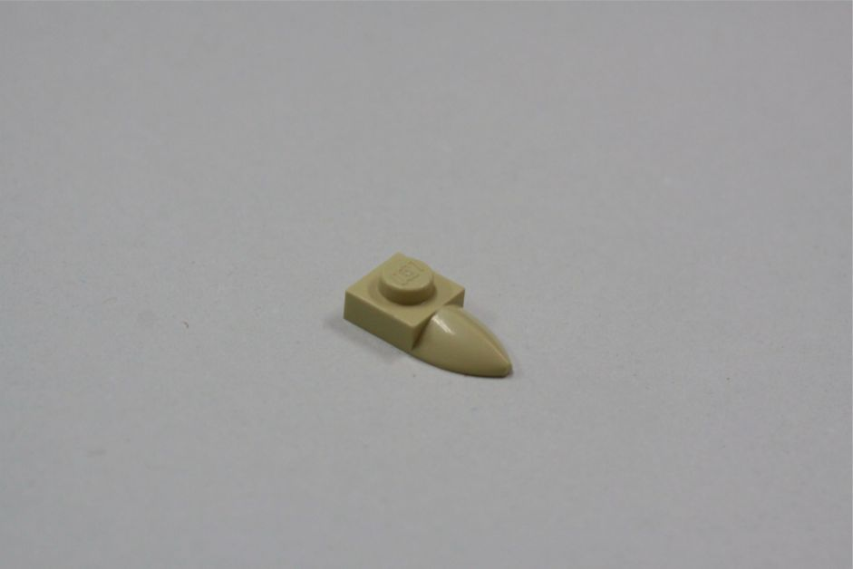

Slide 83
crow

